Slide 1

Arrays of objects
CSC 113: Computer programming II

Slide 2
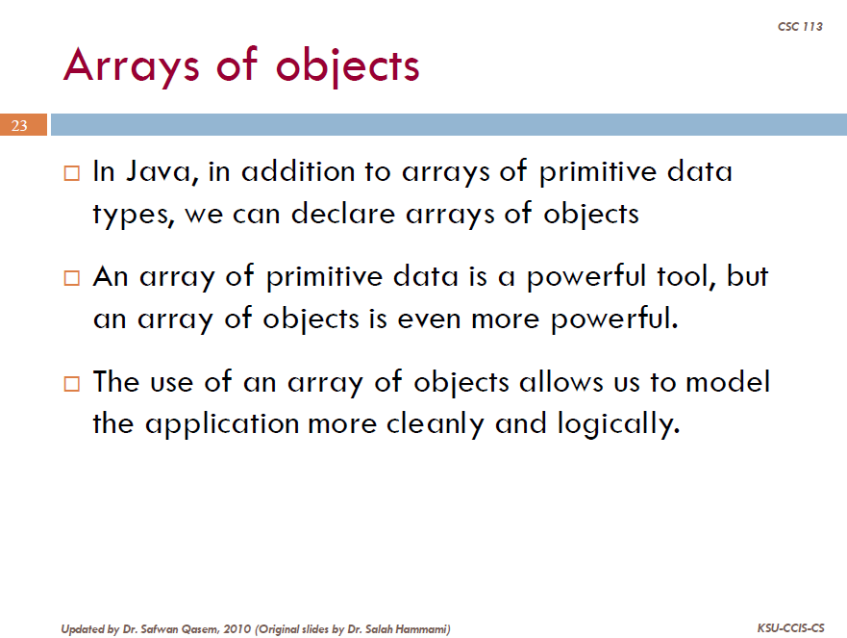

Slide 3
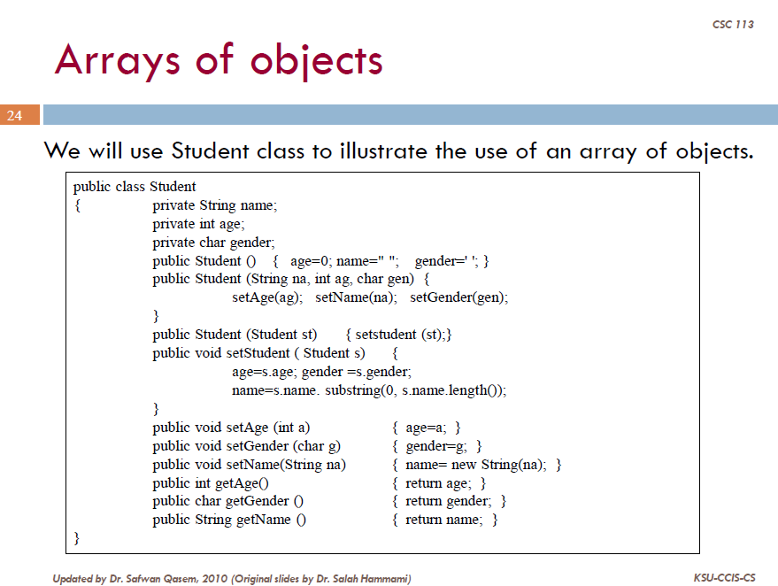

Slide 4
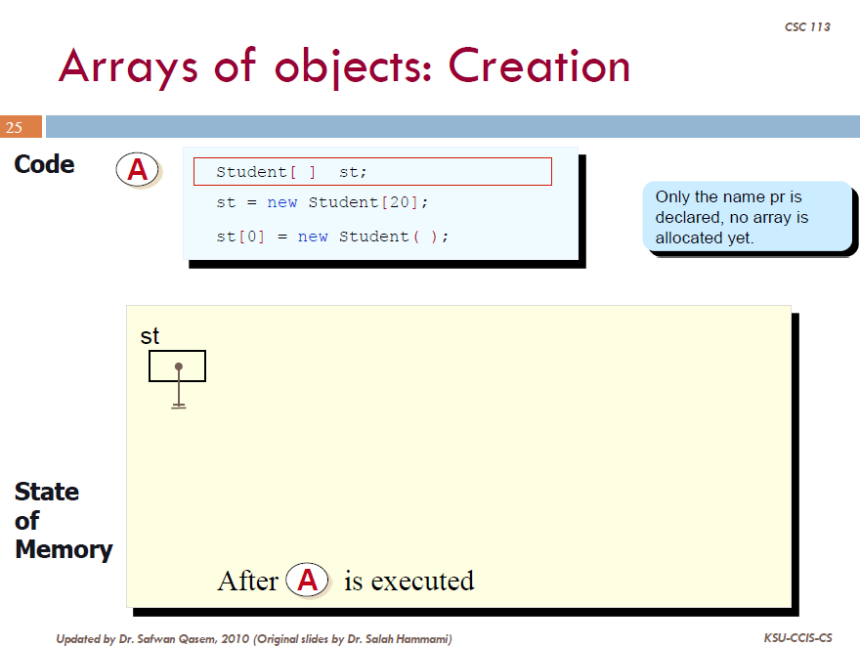

Slide 5
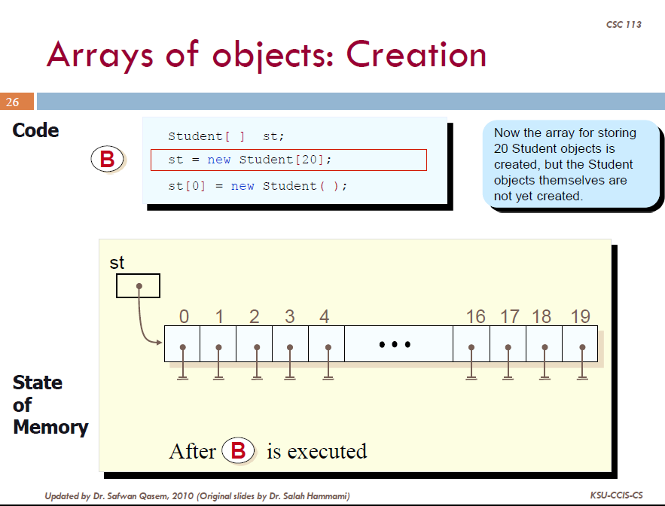

Slide 6
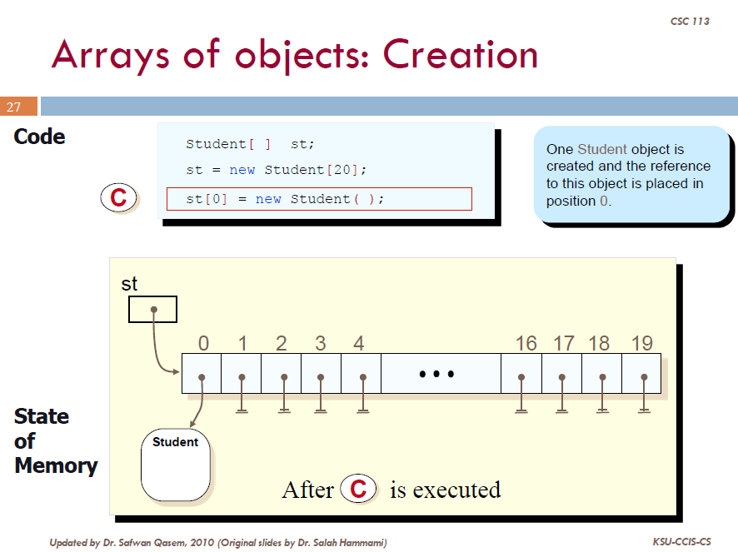

Slide 7
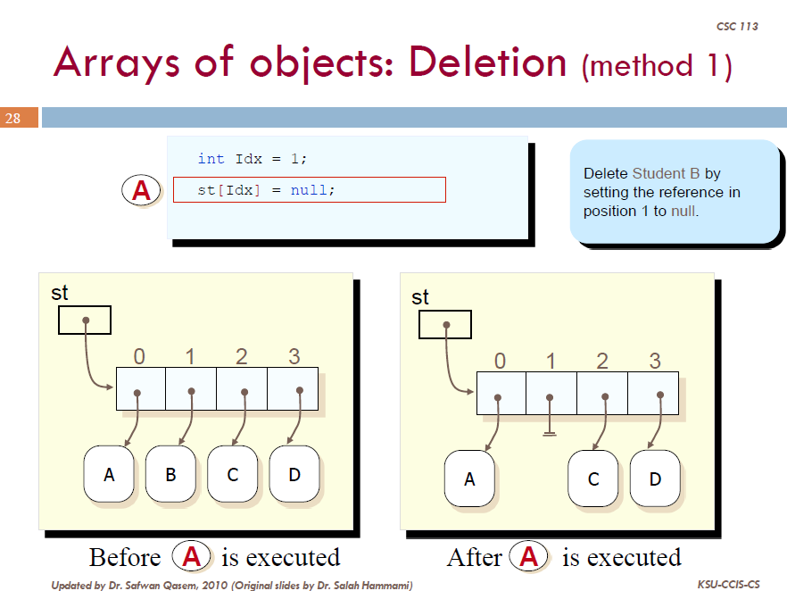

Slide 8
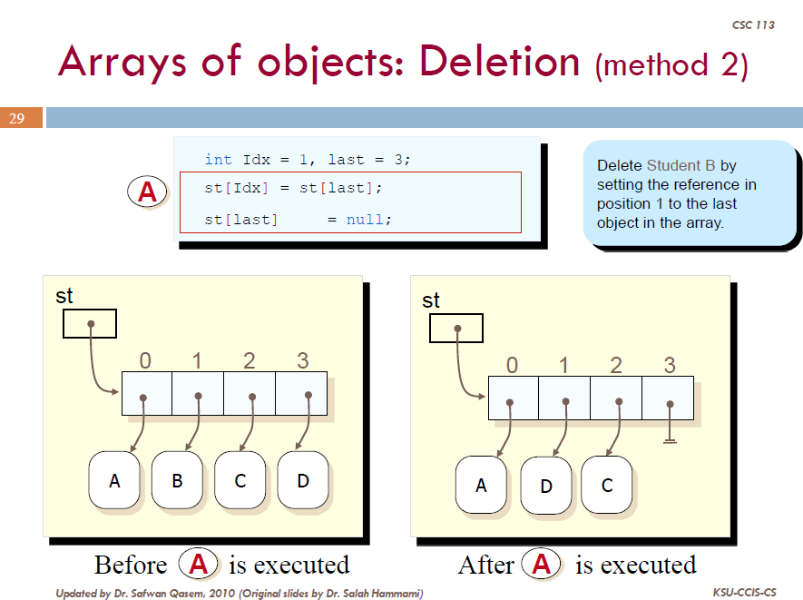

Slide 9
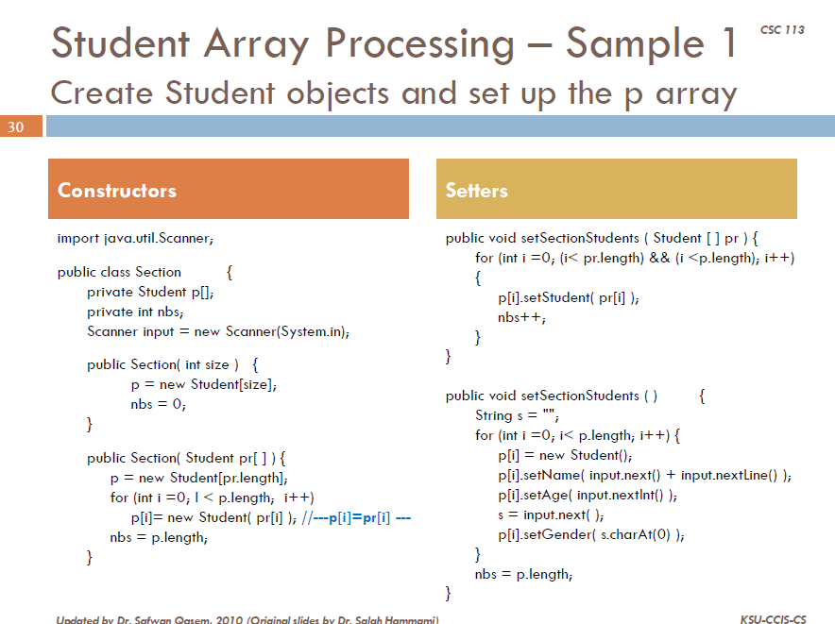
P[i]=new Student();
{
++; }
Notes:
Method setSectionStudent(Student []pr) ➔ assuming the section is empty

Slide 10
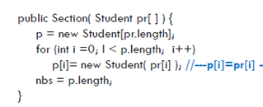

Constructor Section (Student pr[])
{
++; }
Main:
Section sec= new Section(list);
st
s
st
s
st
s
st
s
pr
list
:student
Huda
18
f
:student
Ashwaq
19
f
:student
Nourah
20
f
:student
Sara
19
f
0
1
2
3
4
5
:section
p
sec
1
2
0
3
4
:student
Huda
18
f
:student
Ashwaq
19
f
:student
Nourah
20
f
:student
Sara
19
f

Slide 11
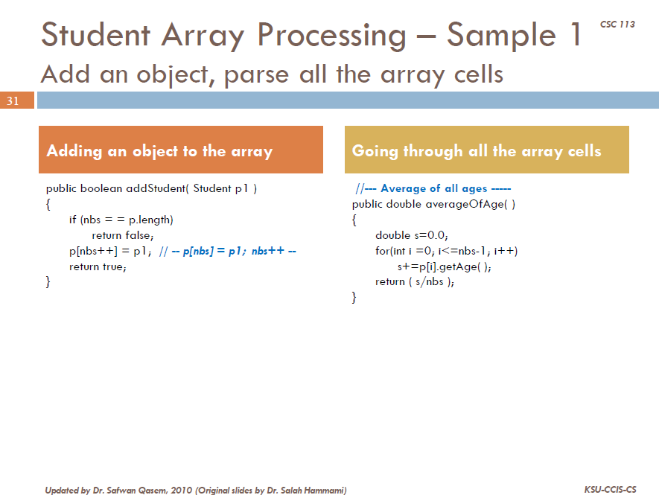

Slide 12
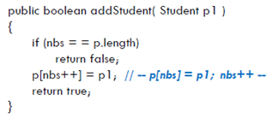
Add an object
Main:
sec .addStudent(std)
:section
p
0
1
2
3
4
5
sec
4
5
:student
Huda
18
f
:student
Ashwaq
19
f
:student
Nourah
20
f
:student
Sara
19
f
p1
:student
Layla
1
f
std

Slide 13
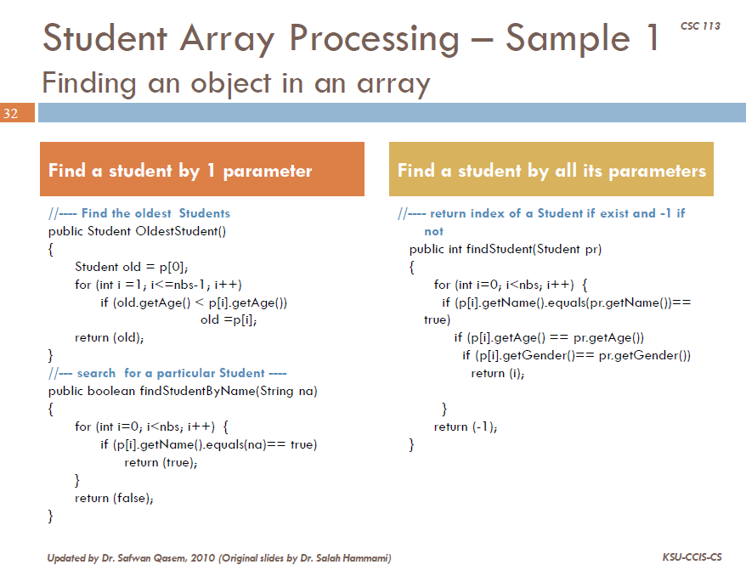

Slide 14
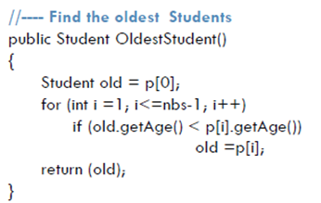
Find student by 1 parameter
sec .oldestStudent()
:section
p
5
0
1
2
3
4
5
sec
:student
Huda
18
f
:student
Ashwaq
19
f
:student
Nourah
20
f
:student
Sara
19
f
:student
Layla
21
f

Slide 15
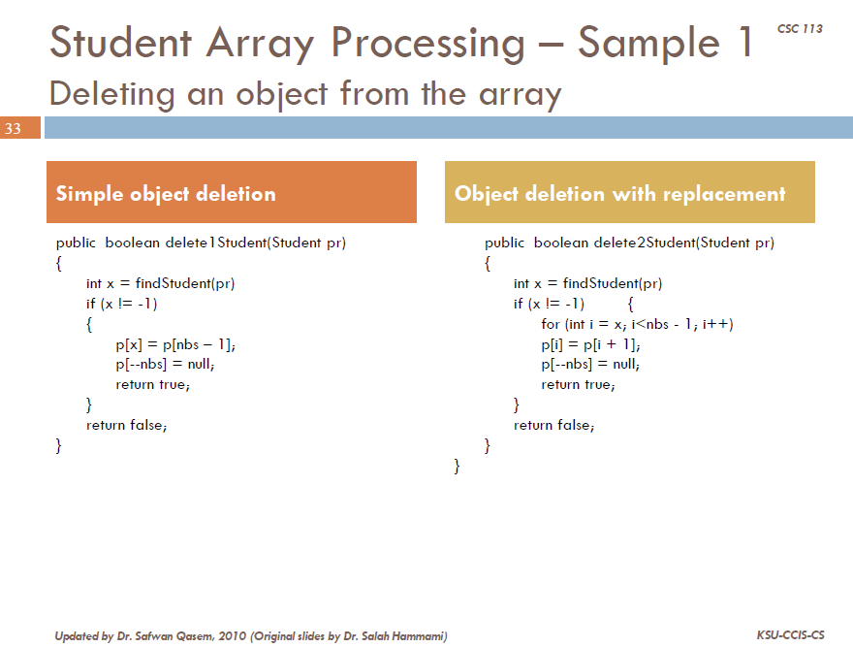

Slide 16
Simple object deletion
:student
Nourah
20
f
Sec . delete1Student(std);
pr
std
:section
p
5
0
1
2
3
4
5
sec
:student
Huda
18
f
:student
Ashwaq
19
f
:student
Nourah
20
f
:student
Sara
19
f
:student
Layla
21
f

Slide 17
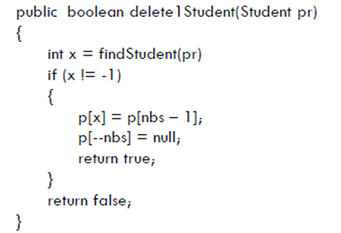
Simple object deletion
:student
Nourah
20
f
Sec . delete1Student(std);
→
X=2
pr
std
:section
p
5
0
1
2
3
4
5
sec
4
:student
Huda
18
f
:student
Ashwaq
19
f
:student
Layla
21
f
:student
Sara
19
f

Slide 18
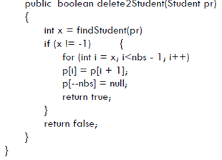
object deletion with replacement
:student
Nourah
20
f
Sec . delete2Student(std);
pr
std
:section
p
5
0
1
2
3
4
5
sec
4
:student
Huda
18
f
:student
Ashwaq
19
f
:student
Nourah
20
f
:student
Sara
19
f
:student
Layla
21
f

